Slide 1
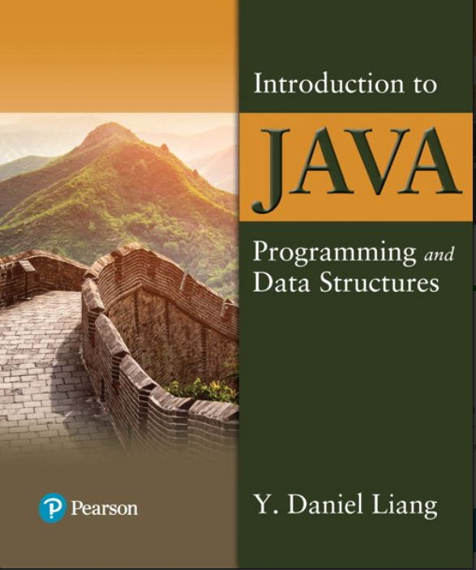

Introduction to Java Programming and Data Structures
Twelfth Edition
Chapter 32
Multithreading and Parallel Programming
Copyright © 2020 Pearson Education, Inc. All Rights Reserved
Notes:
If this PowerPoint presentation contains mathematical equations, you may need to check that your computer has the following installed:
1) MathType Plugin
2) Math Player (free versions available)
3) NVDA Reader (free versions available)
Slides in this presentation contain hyperlinks. JAWS users should be able to get a list of links by using INSERT+F7

Slide 2
Objectives (1 of 2)
32.1 To get an overview of multithreading (§32.2).
32.2 To develop task classes by implementing the Runnable interface (§32.3).
32.3 To create threads to run tasks using the Thread class (§32.3).
32.4 To control threads using the methods in the Thread class (§32.4).
32.5 To control animations using threads and use Platform.runLater to run the code in application thread (§32.5).
32.6 To execute tasks in a thread pool (§32.6).
32.7 To use synchronized methods or blocks to synchronize threads to avoid race conditions (§32.7).
32.8 To synchronize threads using locks (§32.8).
32.9 To facilitate thread communications using conditions on locks (§§32.9–32.10).

Slide 3
Objectives (2 of 2)
32.10 To use blocking queues to synchronize access to an array queue, linked queue, and priority queue (§32.11).
32.11 To restrict the number of accesses to a shared resource using semaphores (§32.12).
32.12 To use the resource-ordering technique to avoid deadlocks (§32.13).
32.13 To describe the life cycle of a thread (§32.14).
32.14 To create synchronized collections using the static methods in the Collections class (§32.15).
32.15 To develop parallel programs using the Fork/Join Framework (§32.16).

Slide 4
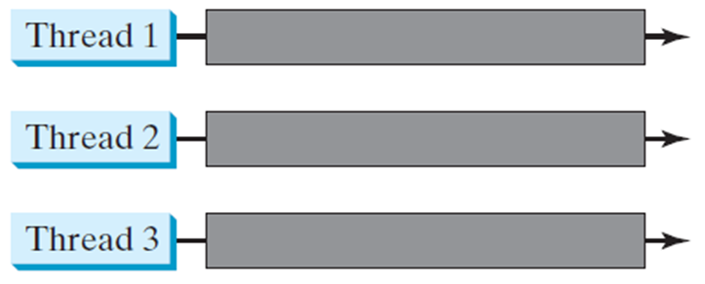
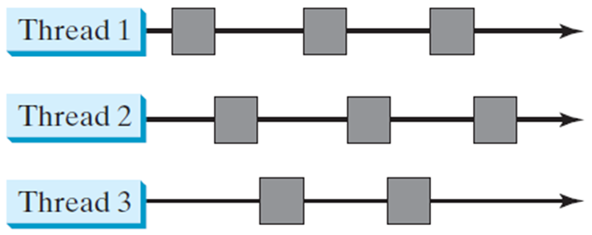
Threads Concept
Multiple threads on multiple C P U s
Multiple threads sharing a single C P U

Slide 5
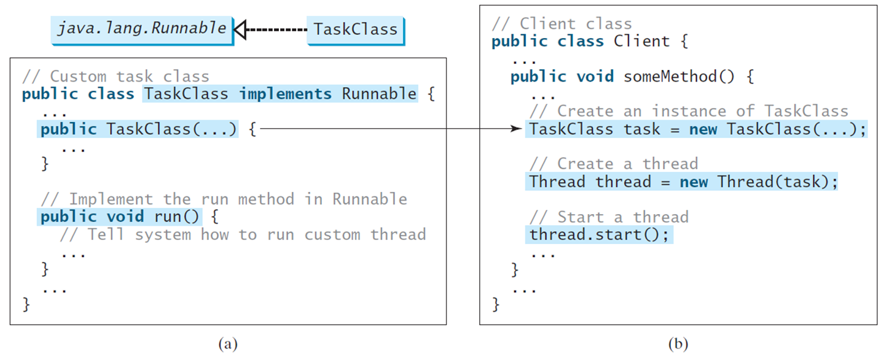
Creating Tasks and Threads
Notes:
First block.
forward slash forward slash Custom task class public class TaskClass implements Runnable
public TaskClass left parenthesis ellipsis right parenthesis left brace
ellipsis
right brace
forward slash forward slash Client class public class Client left brace public void someMethod left parenthesis right parenthesis left brace
forward slash forward slash Implement the run method in Runnable public void run left parenthesis right parenthesis left brace forward slash forward slash Tell system how to run custom thread
ellipsis
right brace
right brace
right brace
ellipsis forward slash forward slash Create an instance of TaskClass TaskClass task = new TaskClass left parenthesis ellipsis right parenthesis
forward slash forward slash Create a thread Thread thread = new Thread left parenthesis task right parenthesis
forward slash forward slash Start a thread thread. start left parenthesis right parenthesis ellipsis
right brace
ellipsis
right brace

Slide 6
Example: Using the Runnable Interface to Create and Launch Threads
Objective: Create and run three threads:
The first thread prints the letter a 100 times.
The second thread prints the letter b 100 times.
The third thread prints the integers 1 through 100.
TaskThreadDemo
Notes:
TaskThreadDemo: https://liveexample.pearsoncmg.com/html/TaskThreadDemo.html

Slide 7
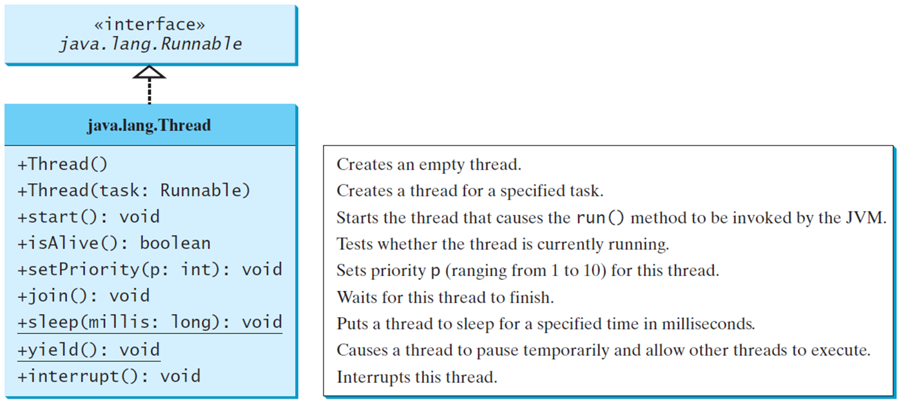
The Thread Class
Notes:
The codes and descriptions for ava.lang.Thread are as follows.
+Thread left parenthesis right parenthesis. Creates an empty thread.
+Thread left parenthesis task colon Runnable right parenthesis. Creates a thread for a specified task.
+start left parenthesis right parenthesis colon void. Starts the thread that causes the run O method to be invoked by the JVM.
+isAlive left parenthesis right parenthesis colon Boolean. Tests whether the thread is currently running.
+setPriority left parenthesis p colon int right parenthesis colon void. Sets priority p (ranging from 1 to 10) for this thread.
+join left parenthesis right parenthesis colon void. Waits for this thread to finish.
+sleep left parenthesis millis colon long right parenthesis colon void. Puts a thread to sleep for a specified time in milliseconds.
+yield left parenthesis right parenthesis colon void. Causes a thread to pause temporarily and allow other threads to execute.
+interrupt left parenthesis right parenthesis colon void. Interrupts this thread.

Slide 8
The Static yield() Method
You can use the yield() method to temporarily release time for other threads. For example, suppose you modify the code in Lines 53-57 in TaskThreadDemo.java as follows:
public void run() {
for (int i = 1; i <= lastNum; i++) {
System.out.print(" " + i);
Thread.yield();
}
}
Every time a number is printed, the print100 thread is yielded. So, the numbers are printed after the characters.

Slide 9
The Static sleep(milliseconds) Method
The sleep(long mills) method puts the thread to sleep for the specified time in milliseconds. For example, suppose you modify the code in Lines 53-57 in TaskThreadDemo.java as follows:
public void run() {
for (int i = 1; i <= lastNum; i++) {
System.out.print(" " + i);
try {
if (i >= 50) Thread.sleep(1);
}
catch (InterruptedException ex) {
}
}
}
Every time a number (>= 50) is printed, the print100 thread is put to sleep for 1 millisecond.

Slide 10
The join() Method
You can use the join() method to force one thread to wait for another thread to finish. For example, suppose you modify the code in Lines 53-57 in TaskThreadDemo.java as follows:
The numbers after 50 are printed after thread printA is finished.
Notes:
public void run left parenthesis right parenthesis left brace
Thread thread4 = new Thread left parenthesis
new PrintChar left parenthesis c, 40 right parenthesis right parenthesis semi colon
thread4.start left parenthesis right parenthesis semi colon
try left brace
for left parenthesis int i = 1 semi colon i <= lastNum semi colon i++ right parenthesis left brace
System.out.print left parenthesis double quotation marks double quotation marks + i right parenthesis semi colon
if left parenthesis i == 50 right parenthesis thread4.join left parenthesis right parenthesis semi colon
right brace
right brace
catch left parenthesis InterruptedException ex right parenthesis left brace
right brace
A diagram shows a box with text, printA.join left parenthesis right parenthesis. An arrow pointing downward form the box is labeled, wait for printA to finish. To the right is an arrow pointing from thread printA to printA finished. An arrow points from printA finished to the box.

Slide 11
isAlive(), interrupt(), and isInterrupted()
The isAlive() method is used to find out the state of a thread. It returns true if a thread is in the Ready, Blocked, or Running state; it returns false if a thread is new and has not started or if it is finished.
The interrupt() method interrupts a thread in the following way: If a thread is currently in the Ready or Running state, its interrupted flag is set; if a thread is currently blocked, it is awakened and enters the Ready state, and an java.io.InterruptedException is thrown.
The isInterrupt() method tests whether the thread is interrupted.

Slide 12
The deprecated stop(), suspend(), and resume() Methods
Note: The Thread class also contains the stop(), suspend(), and resume() methods. As of Java 2, these methods are deprecated (or outdated) because they are known to be inherently unsafe. You should assign null to a Thread variable to indicate that it is stopped rather than use the stop() method.

Slide 13
Thread Priority
Each thread is assigned a default priority of Thread.NORM_PRIORITY. You can reset the priority using setPriority(int priority).
Some constants for priorities include Thread.MIN_PRIORITY Thread.MAX_PRIORITY Thread.NORM_PRIORITY

Slide 14
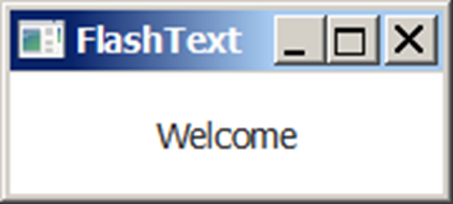
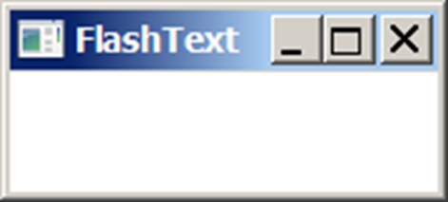

Example: Flashing Text
FlashText
Notes:
FlashText: https://liveexample.pearsoncmg.com/html/FlashText.html

Slide 15
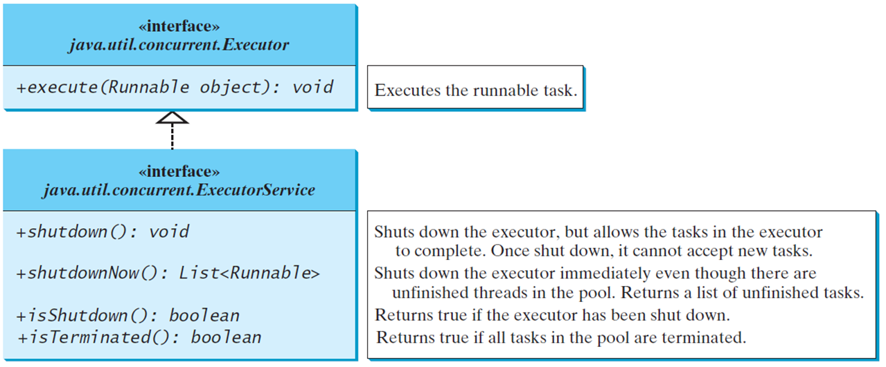
Thread Pools
Starting a new thread for each task could limit throughput and cause poor performance. A thread pool is ideal to manage the number of tasks executing concurrently. J D K 1.5 uses the Executor interface for executing tasks in a thread pool and the ExecutorService interface for managing and controlling tasks. ExecutorService is a subinterface of Executor.
Notes:
The code and description for the interface java.utaconcurrent.Executor are as follows.
+execute left parenthesis Runnable object right parenthesis colon void. Executes the runnable task.
The codes and descriptions for the interface java.util.concurrent.ExecutorServi are as follows.
+shutdown0 colon void. Shuts down the executor, but allows the tasks in the executor to complete. Once shut down, it cannot accept new tasks.
+shutdownNow left parenthesis right parenthesis colon List less than symbol Runnable greater than symbol. Shuts down the executor immediately even though there are unfinished threads in the pool. Returns a list of unfinished tasks.
+isShutdown left parenthesis right parenthesis colon Boolean. Returns true if the executor has been shut down.
+i sTerminated left parenthesis right parenthesis colon boolean. Returns true if all tasks in the pool are terminated.

Slide 16
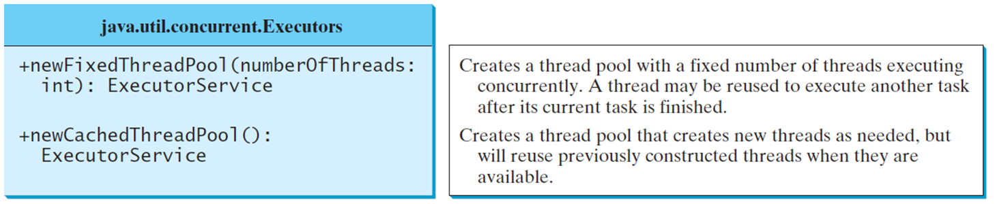
Creating Executors
To create an Executor object, use the static methods in the Executors class.
ExecutorDemo
Notes:
+newFixedThreadPool left parenthesis numberOfThreads colon int right parenthesis colon ExecutorService. Creates a thread pool with a fixed number of threads executing concurrently. A thread may be reused to execute another task after its current task is finished.
+newCachedThreadPool 0 colon ExecutorService. Creates a thread pool that creates new threads as needed, but will reuse previously constructed threads when they are available.
ExecutorDemo: https://liveexample.pearsoncmg.com/html/ExecutorDemo.html

Slide 17
Thread Synchronization
A shared resource may be corrupted if it is accessed simultaneously by multiple threads. For example, two unsynchronized threads accessing the same bank account may cause conflict.
Notes:
Row 1. 1, 0, newBalance =bank getBalance0 + 1, blank.
Row 2. 2, 0, blank, bank setBalance left parenthesis newBalance right parenthesis.
Row 3. 3 1, newBalance = bank getBalance left parenthesis right parenthesis + 1, blank.
Row 4. 4, 1, blank, banks etBalance left parenthesis newBalance right parenthesis.

Slide 18
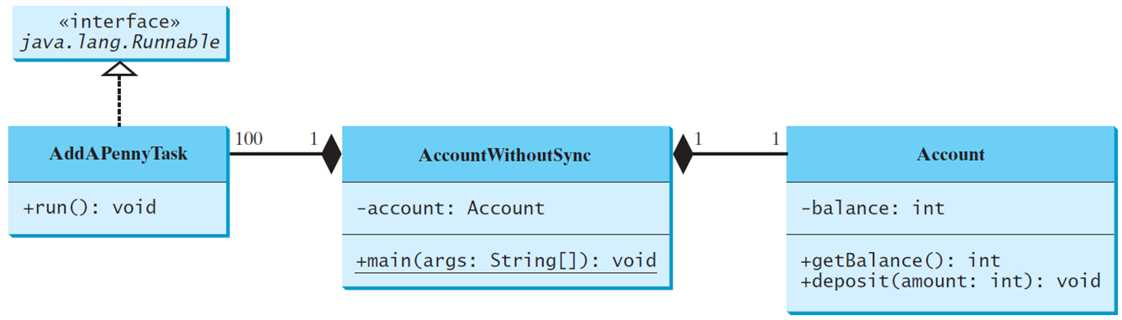
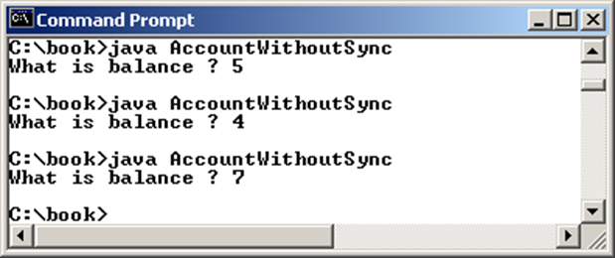
Example: Showing Resource Conflict
Objective: Write a program that demonstrates the problem of resource conflict. Suppose that you create and launch one hundred threads, each of which adds a penny to an account. Assume that the account is initially empty.
AccountWithoutSync
Notes:
A horizontal line connect AddAPennyTask and AccountWithoutSync with 100 near former and 1 near later. A horizontal line connect AccountWithoutSync and Account with 1 near each end. There is a shaded rhombus near each end of AccountWithoutSync. The codes for AddAPennyTask are as follows.
+run left parenthesis right parenthesis colon void.
The codes for AccountWithoutSync are as follows.
Hyphen account colon Account
+main left parenthesis args colon String left bracket right bracket right parenthesis colon void
The codes for Account are as follows.
Hyphen balancecolon int
+getBalance left parenthesis right parenthesis colon int
+deposit left parenthesis amount colon int right parenthesis colon void
C colon backslash book greater than symbol java AccountWithoutSync What is balance question mark S
C colon backslash book greater than symbol java AccountWithoutSync What is balance question mark 4
C colon backslash book greater than symbol java AccountWithoutSync What is balance question mark 7
C colon backslash book greater than symbol
AccountWithoutSync: https://liveexample.pearsoncmg.com/html/AccountWithoutSync.html

Slide 19
Race Condition
What, then, caused the error in the example? Here is a possible scenario:
The effect of this scenario is that Task 1 did nothing, because in Step 4 Task 2 overrides Task 1's result. Obviously, the problem is that Task 1 and Task 2 are accessing a common resource in a way that causes conflict. This is a common problem known as a race condition in multithreaded programs. A class is said to be thread-safe if an object of the class does not cause a race condition in the presence of multiple threads. As demonstrated in the preceding example, the Account class is not thread-safe.
Notes:
Row 1. 1, 0, newBalance = balance + 1, blank.
Row 2. 2, 0, blank, newBalance = balance + or minus 1.
Row 3. 3, 1, balance = newBalance, blank.
Row 4. 4, 1, blank, balance = newBalance.
The numbers 2 and 4 in step column and entire Task 2 column are highlighted.

Slide 20
The synchronized keyword
To avoid race conditions, more than one thread must be prevented from simultaneously entering certain part of the program, known as critical region. The critical region in the Listing 32.5 is the entire deposit method. You can use the synchronized keyword to synchronize the method so that only one thread can access the method at a time. There are several ways to correct the problem in Listing 32.5, one approach is to make Account thread-safe by adding the syncronized keyword in the deposit method in Line 45 as follows:
public synchronized void deposit(double amount)

Slide 21
Synchronizing Instance Methods and Static Methods (1 of 2)
A synchronized method acquires a lock before it executes. In the case of an instance method, the lock is on the object for which the method was invoked. In the case of a static method, the lock is on the class. If one thread invokes a synchronized instance method (respectively, static method) on an object, the lock of that object (respectively, class) is acquired first, then the method is executed, and finally the lock is released. Another thread invoking the same method of that object (respectively, class) is blocked until the lock is released.

Slide 22
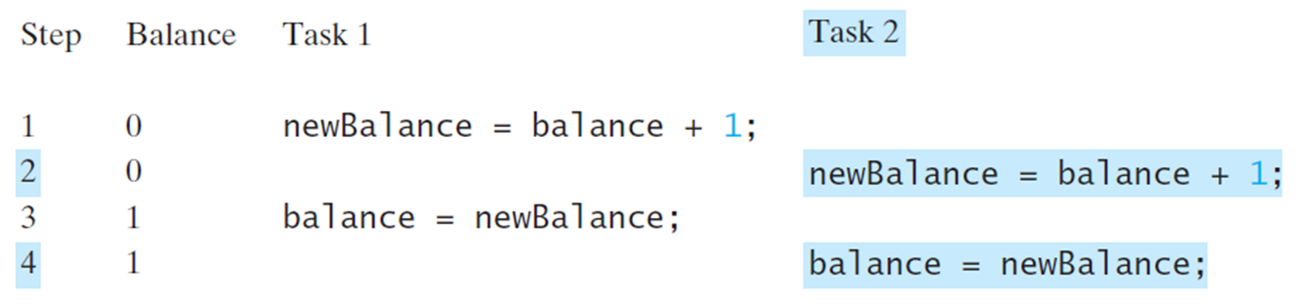
Synchronizing Instance Methods and Static Methods (2 of 2)
With the deposit method synchronized, the preceding scenario cannot happen. If Task 2 starts to enter the method, and Task 1 is already in the method, Task 2 is blocked until Task 1 finishes the method.
Notes:
Row 1. 1, 0, newBalance = balance + 1, blank.
Row 2. 2, 0, blank, newBalance = balance + 1.
Row 3. 3, 1, balance = newBalance, blank.
Row 4. 4, 1, blank, balance = newBalance.
The numbers 2 and 4 in step column and entire Task 2 column are highlighted.

Slide 23
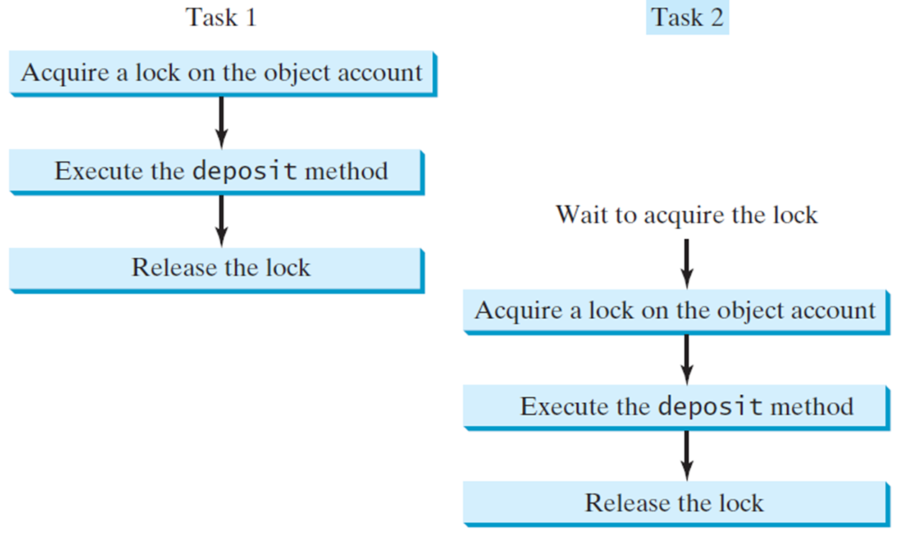
Synchronizing Tasks
Notes:
Acquire a lock on the object account
Execute the deposit method
Release the lock
Task 2
Wait to acquire the lock
Acquire a lock on the object account
Execute the deposit method
Release the lock.

Slide 24
Synchronizing Statements
Invoking a synchronized instance method of an object acquires a lock on the object, and invoking a synchronized static method of a class acquires a lock on the class. A synchronized statement can be used to acquire a lock on any object, not just this object, when executing a block of the code in a method. This block is referred to as a synchronized block. The general form of a synchronized statement is as follows:
synchronized (expr) {
statements;
}
The expression expr must evaluate to an object reference. If the object is already locked by another thread, the thread is blocked until the lock is released. When a lock is obtained on the object, the statements in the synchronized block are executed, and then the lock is released.

Slide 25
Synchronizing Statements versus Methods
Any synchronized instance method can be converted into a synchronized statement. Suppose that the following is a synchronized instance method:
public synchronized void xMethod() {
// method body
}
This method is equivalent to
public void xMethod() {
synchronized (this) {
// method body
}
}

Slide 26
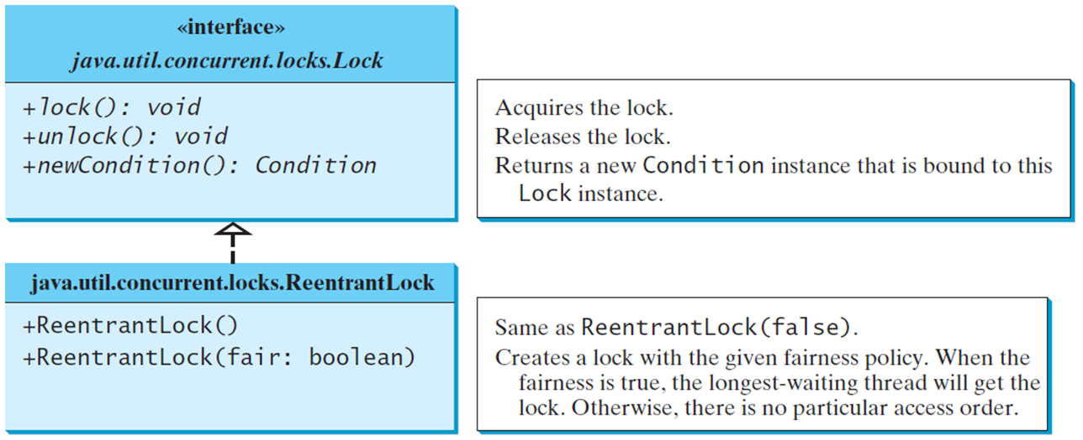
Synchronization Using Locks
A synchronized instance method implicitly acquires a lock on the instance before it executes the method.
J D K 1.5 enables you to use locks explicitly. The new locking features are flexible and give you more control for coordinating threads. A lock is an instance of the Lock interface, which declares the methods for acquiring and releasing locks. A lock may also use the newCondition() method to create any number of Condition objects, which can be used for thread communications.
Notes:
java.util.concurrent.locks.Lock. The codes and descriptions for the interface java.util.concurrent.locks.Lock are as follows.
+lock left parenthesis right parenthesis colon void. Acquires the lock.
+unlock left parenthesis right parenthesis colon void. Releases the lock.
+newCondition left parenthesis right parenthesis colon Condition. Returns a new Condition instance that is bound to this Lock instance.
The codes and description for java.util.concurrent.locks.ReentrantLock are as follows.
+ReentrantLock left parenthesis right parenthesis. Same as ReentrantLock (false).
+ReentrantLock left parenthesis fair colon boolean right parenthesis. Creates a lock with the given fairness policy. When the fairness is true, the longest waiting thread will get the lock. Otherwise, there is no particular access order.

Slide 27
Fairness Policy
ReentrantLock is a concrete implementation of Lock for creating mutual exclusive locks. You can create a lock with the specified fairness policy. True fairness policies guarantee the longest-wait thread to obtain the lock first. False fairness policies grant a lock to a waiting thread without any access order. Programs using fair locks accessed by many threads may have poor overall performance than those using the default setting, but have smaller variances in times to obtain locks and guarantee lack of starvation.

Slide 28
Example: Using Locks
This example revises AccountWithoutSync.java to synchronize the account modification using explicit locks.
AccountWithSyncUsingLock
Notes:
AccountWithSyncUsingLock: https://liveexample.pearsoncmg.com/html/AccountWithSyncUsingLock.html

Slide 29
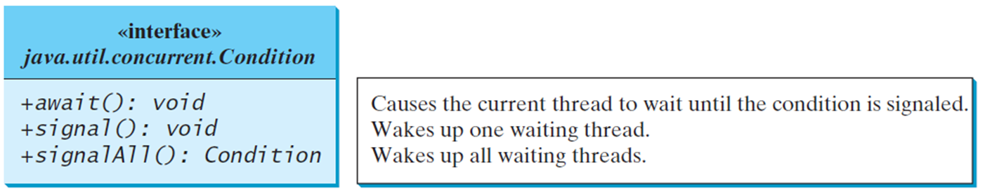
Cooperation Among Threads (1 of 2)
The conditions can be used to facilitate communications among threads. A thread can specify what to do under a certain condition. Conditions are objects created by invoking the newCondition() method on a Lock object. Once a condition is created, you can use its await(), signal(), and signalAll() methods for thread communications. The await() method causes the current thread to wait until the condition is signaled. The signal() method wakes up one waiting thread, and the signalAll() method wakes all waiting threads.
Notes:
+await left parenthesis right parenthesis void. Causes the current thread to wait until the condition is signaled.
+signal colon void. Wakes up one waiting thread.
+signalAll colon Condition. Wakes up all waiting threads.

Slide 30
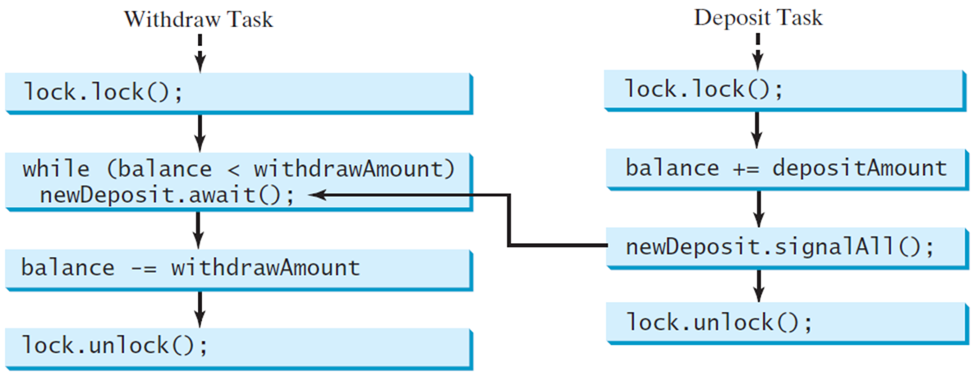
Cooperation Among Threads (2 of 2)
To synchronize the operations, use a lock with a condition: newDeposit (i.e., new deposit added to the account). If the balance is less than the amount to be withdrawn, the withdraw task will wait for the newDeposit condition. When the deposit task adds money to the account, the task signals the waiting withdraw task to try again.
Notes:
lock . lock left parenthesis right parenthesis semi colon
while left parenthesis balance less than symbol withdrawAmount right parenthesis newDeposit.await left parenthesis right parenthesis semi colon
balance minus = withdrawAmount
lock . unlock left parenthesis right parenthesis semi colon
Deposit Task
lock . lock left parenthesis right parenthesis semi colon
balance += depositAmount
newDeposit.signalAll left parenthesis right parenthesis semi colon
lock . unlock left parenthesis right parenthesis semi colon
An arrow points from newDeposit.signalAll left parenthesis right parenthesis semi colon to while left parenthesis balance less than symbol withdrawAmount right parenthesis newDeposit.await left parenthesis right parenthesis semi colon.

Slide 31
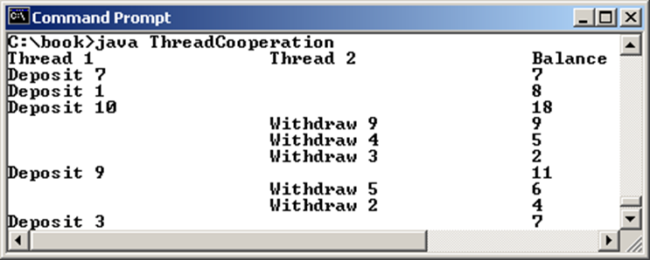
Example: Thread Cooperation
Write a program that demonstrates thread cooperation. Suppose that you create and launch two threads, one deposits to an account, and the other withdraws from the same account. The second thread has to wait if the amount to be withdrawn is more than the current balance in the account. Whenever new fund is deposited to the account, the first thread notifies the second thread to resume. If the amount is still not enough for a withdrawal, the second thread has to continue to wait for more fund in the account. Assume the initial balance is 0 and the amount to deposit and to withdraw is randomly generated
ThreadCooperation
Notes:
C colon backslash hook less than symbol java ThreadCooperation
Thread 1, Thread 2, Balance.
Deposit, 7, blank, 7.
Deposit, 1, 8.
Deposit, 10, 18.
Withdraw, 9, 9.
Withdraw, 4, 5.
Withdraw, 3, 2.
Deposit, 9, 11.
Withdraw, 5, 6.
Withdraw, 2, 4.
Deposit, 3, 7.
ThreadCooperation: https://liveexample.pearsoncmg.com/html/ThreadCooperation.html

Slide 32
Java’s Built-in Monitors (Optional)
Locks and conditions are new in Java 5. Prior to Java 5, thread communications are programmed using object’s built-in monitors. Locks and conditions are more powerful and flexible than the built-in monitor. For this reason, this section can be completely ignored. However, if you work with legacy Java code, you may encounter the Java’s built-in monitor. A monitor is an object with mutual exclusion and synchronization capabilities. Only one thread can execute a method at a time in the monitor. A thread enters the monitor by acquiring a lock on the monitor and exits by releasing the lock. Any object can be a monitor. An object becomes a monitor once a thread locks it. Locking is implemented using the synchronized keyword on a method or a block. A thread must acquire a lock before executing a synchronized method or block. A thread can wait in a monitor if the condition is not right for it to continue executing in the monitor.

Slide 33
wait(), notify(), and notifyAll()
Use the wait(), notify(), and notifyAll() methods to facilitate communication among threads.
The wait(), notify(), and notifyAll() methods must be called in a synchronized method or a synchronized block on the calling object of these methods. Otherwise, an IllegalMonitorStateException would occur.
The wait() method lets the thread wait until some condition occurs. When it occurs, you can use the notify() or notifyAll() methods to notify the waiting threads to resume normal execution. The notifyAll() method wakes up all waiting threads, while notify() picks up only one thread from a waiting queue.

Slide 34
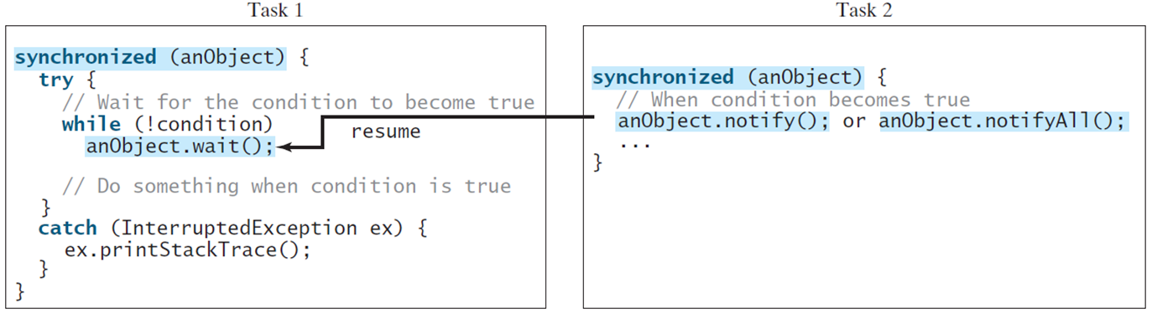
Example: Using Monitor
The wait(), notify(), and notifyAll() methods must be called in a synchronized method or a synchronized block on the receiving object of these methods. Otherwise, an IllegalMonitorStateException will occur.
When wait() is invoked, it pauses the thread and simultaneously releases the lock on the object. When the thread is restarted after being notified, the lock is automatically reacquired.
The wait(), notify(), and notifyAll() methods on an object are analogous to the await(), signal(), and signalAll() methods on a condition.
Notes:
try left brace forward slash forward slash Wait for the condition to become true
while left parenthesis exclamation mark condition right parenthesis anObject.wait left parenthesis right parenthesis semi colon
forward slash forward slash Do something when condition is true
right brace
catch left parenthesis InterruptedException ex right parenthesis left brace ex.printStackTrace left parenthesis right parenthesis semi colon
Task 2
synchronized left parenthesis anObject right parenthesis left brace
forward slash forward slash When condition becomes true
anObject.notify left parenthesis right parenthesis semi colon or anObject.notifyAll left parenthesis right parenthesis semi colon
ellipsis
right brace
An arrow from anObject.notify left parenthesis right parenthesis semi colon or anObject.notifyAll left parenthesis right parenthesis semi colon in Task 2 to anObject.wait left parenthesis right parenthesis semi colon in Task 1 is labeled, resume.

Slide 35
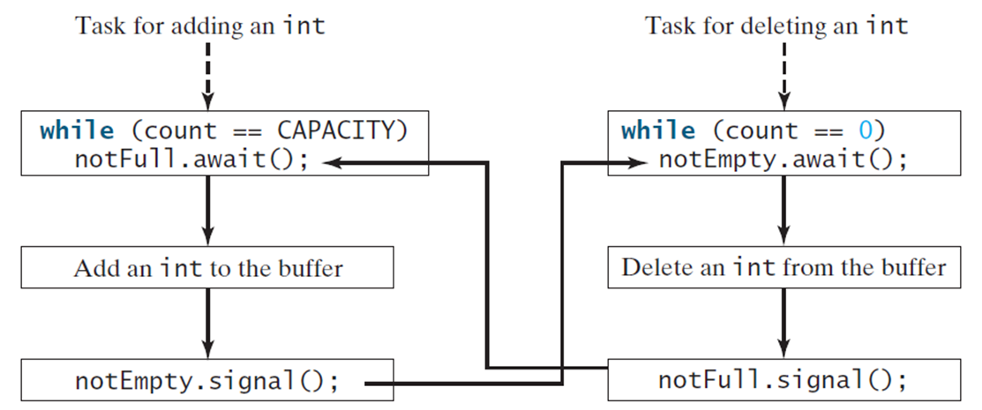
Case Study: Producer/Consumer (Optional) (1 of 2)
Consider the classic Consumer/Producer example. Suppose you use a buffer to store integers. The buffer size is limited. The buffer provides the method write(int) to add an int value to the buffer and the method read() to read and delete an int value from the buffer. To synchronize the operations, use a lock with two conditions: notEmpty (i.e., buffer is not empty) and notFull (i.e., buffer is not full). When a task adds an int to the buffer, if the buffer is full, the task will wait for the notFull condition. When a task deletes an int from the buffer, if the buffer is empty, the task will wait for the notEmpty condition.
Notes:
while left parenthesis count == CAPACITY right parenthesis notFull . await semi colon
Add an int to the buffer
notEmpty.signal left parenthesis right parenthesis semi colon
Task for deleting an int
while left parenthesis count == 0 right parenthesis notEmpty.await left parenthesis right parenthesis semi colon
Delete an int from the buffer
notFull.signal left parenthesis right parenthesis semi colon
An arrow from notEmpty.signal left parenthesis right parenthesis semi colon first code block points to notEmpty.await left parenthesis right parenthesis in the second code block.
An arrow from notFull.signal left parenthesis right parenthesis in the second code block points to notFull . await in the first code block.

Slide 36
Case Study: Producer/Consumer (Optional) (2 of 2)
Listing 32.8 presents the complete program. The program contains the Buffer class (lines 43-89) and two tasks for repeatedly producing and consuming numbers to and from the buffer (lines 15-41). The write(int) method (line 58) adds an integer to the buffer. The read() method (line 75) deletes and returns an integer from the buffer.
For simplicity, the buffer is implemented using a linked list (lines 48-49). Two conditions notEmpty and notFull on the lock are created in lines 55-56. The conditions are bound to a lock. A lock must be acquired before a condition can be applied. If you use the wait() and notify() methods to rewrite this example, you have to designate two objects as monitors.
ConsumerProducer
Notes:
ConsumerProducer: https://liveexample.pearsoncmg.com/html/ConsumerProducer.html

Slide 37
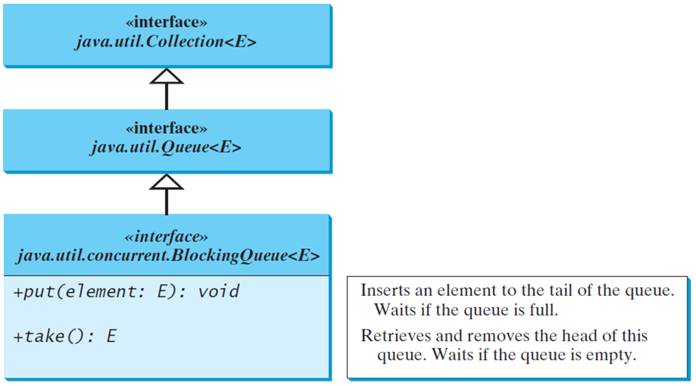
Blocking Queues (Optional)
§22.8 introduced queues and priority queues. A blocking queue causes a thread to block when you try to add an element to a full queue or to remove an element from an empty queue.
Notes:
concurrent.BlockingQueue less than symbol E greater than symbol leading to the interface java.utiLQueue less than symbol E greater than symbol which further leads to the interface java.utiLCollection less than symbol E greater than symbol. The codes and descriptions for the interface java. util. concurrent.BlockingQueue less than symbol E greater than symbol are as follows.
+put left parenthesis element: E right parenthesis colon void. Inserts an element to the tail of the queue. Waits if the queue is full.
+takeO colon E. Retrieves and removes the head of this queue. Waits if the queue is empty.

Slide 38
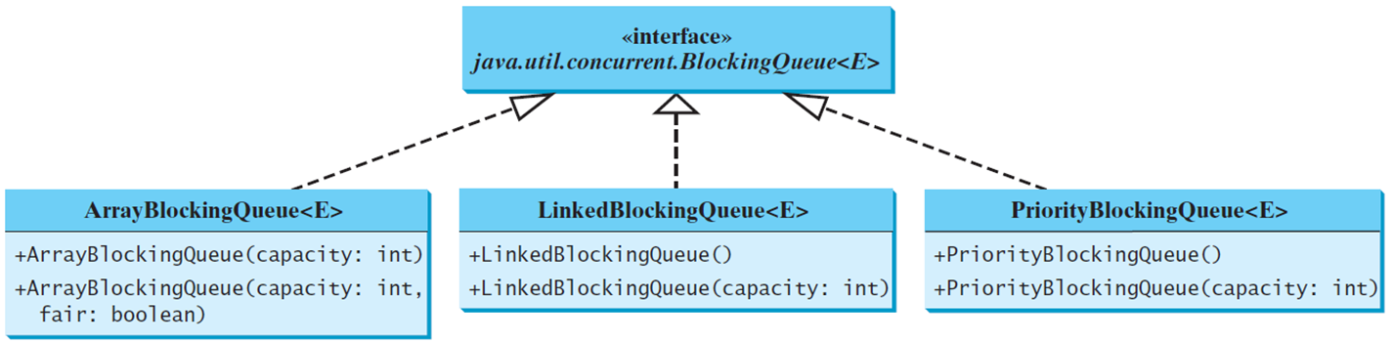
Concrete Blocking Queues
Three concrete blocking queues ArrayBlockingQueue, LinkedBlockingQueue, and PriorityBlockingQueue are supported in J D K 1.5. All are in the java.util.concurrent package. ArrayBlockingQueue implements a blocking queue using an array. You have to specify a capacity or an optional fairness to construct an ArrayBlockingQueue. LinkedBlockingQueue implements a blocking queue using a linked list. You may create an unbounded or bounded LinkedBlockingQueue. PriorityBlockingQueue is a priority queue. You may create an unbounded or bounded priority queue.
Notes:
BlockingQueue less than symbol E greater than symbol. The codes for ArrayBlockingQueue less than symbol E greater than symbol are as follows.
+ArrayBlockingQueue left parenthesis capacity colon int right parenthesis
+ArrayBlockingQueue left parenthesis capacity colon int, fair colon boolean right parenthesis
The codes for LinkedBlockingQueue less than symbol E greater than symbol are as follows.
+LinkedBlockingQueue left parenthesis right parenthesis
+Li nkedBlockingQueue left parenthesis capacity colon int right parenthesis
The codes for PriorityBlockingQueue less than symbol E greater than symbol are as follows.
+Priori tyBlocki ngQueue left parenthesis right parenthesis
+Priori tyBlocki ngQueue left parenthesis capacity colon int right parenthesis

Slide 39
Producer/Consumer Using Blocking Queues
The program gives an example of using an ArrayBlockingQueue for the Consumer/Producer problem.
ConsumerProducerUsingBlockingQueue
Notes:
ConsumerProducerUsingBlockingQueue: https://liveexample.pearsoncmg.com/html/ConsumerProducerUsingBlockingQueue.html

Slide 40
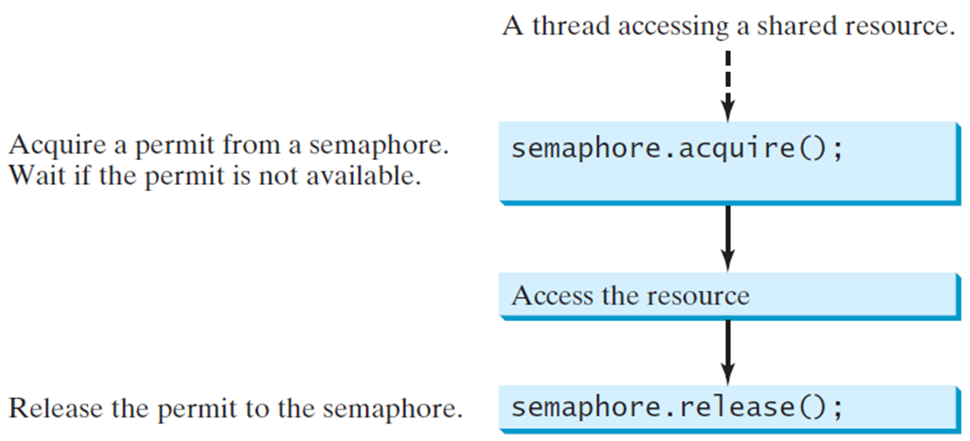
Semaphores (Optional)
Semaphores can be used to restrict the number of threads that access a shared resource. Before accessing the resource, a thread must acquire a permit from the semaphore. After finishing with the resource, the thread must return the permit back to the semaphore.
Notes:
acquire left parenthesis right parenthesis semi colon which leads to access the resource which further leads to semaphore . release left parenthesis right parenthesis semi colon.
The code semaphore . acquire left parenthesis right parenthesis is labeled, acquire a permit from a semaphore. Wait if the permit is not available. The code semaphore . release left parenthesis right parenthesis semi colon is labeled, release the permit to the semaphore.

Slide 41
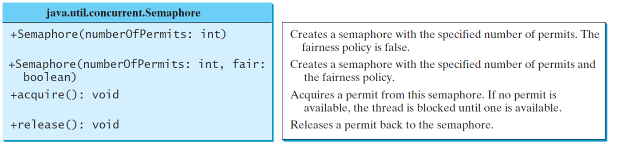
Creating Semaphores
To create a semaphore, you have to specify the number of permits with an optional fairness policy. A task acquires a permit by invoking the semaphore’s acquire() method and releases the permit by invoking the semaphore’s release() method. Once a permit is acquired, the total number of available permits in a semaphore is reduced by 1. Once a permit is released, the total number of available permits in a semaphore is increased by 1.
Notes:
+Semaphore left parenthesis number0fPermits colon int right parenthesis. Creates a semaphore with the specified number of permits. The fairness policy is false.
+Semaphore left parenthesis numberOfPermi ts colon int, fair colon boolean right parenthesis. Creates a semaphore with the specified number of permits and the fairness policy.
+acquire left parenthesis right parenthesis colon void. Acquires a permit from this semaphore. If no permit is available, the thread is blocked until one is available.
+release left parenthesis right parenthesis colon void. Releases a permit back to the semaphore.

Slide 42
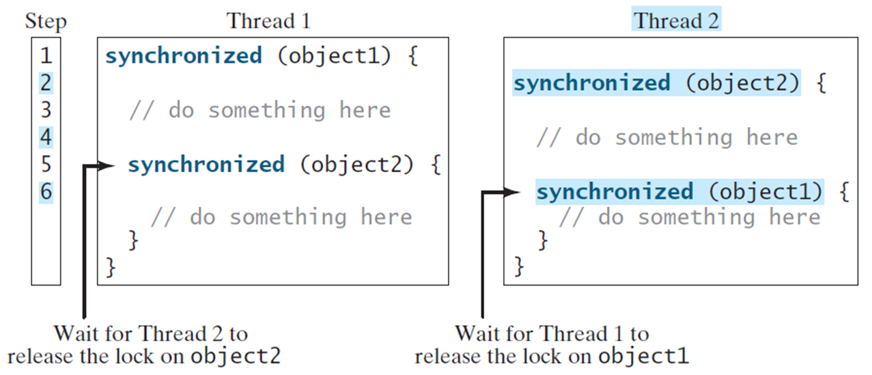
Deadlock
Sometimes two or more threads need to acquire the locks on several shared objects. This could cause deadlock, in which each thread has the lock on one of the objects and is waiting for the lock on the other object. Consider the scenario with two threads and two objects. Thread 1 acquired a lock on object1 and Thread 2 acquired a lock on object2. Now Thread 1 is waiting for the lock on object2 and Thread 2 for the lock on object1. The two threads wait for each other to release the in order to get the lock, and neither can continue to run.
Notes:
Thread 1.
synchronized left parenthesis object right parenthesis left brace
forward slash forward slash do something here
synchronized left parenthesis object2 right parenthesis left brace
forward slash forward slash do something here
right brace
right brace
A arrow pointing to synchronized left parenthesis object2 right parenthesis left brace is labeled, wait for Thread 2 to release the lock on object2.
Thread 2
synchronized left parenthesis object2 right parenthesis
forward slash forward slash do something here
synchronized left parenthesis object right parenthesis
forward slash forward slash do something here right brace
An object pointing to synchronized left parenthesis object1 right parenthesis left brace is labeled, wait for Thread I to release the lock on object 1.

Slide 43
Preventing Deadlock
Deadlock can be easily avoided by using a simple technique known as resource ordering. With this technique, you assign an order on all the objects whose locks must be acquired and ensure that each thread acquires the locks in that order. For the example, suppose the objects are ordered as object1 and object2. Using the resource ordering technique, Thread 2 must acquire a lock on object1 first, then on object2. Once Thread 1 acquired a lock on object1, Thread 2 has to wait for a lock on object1. So Thread 1 will be able to acquire a lock on object2 and no deadlock would occur.

Slide 44
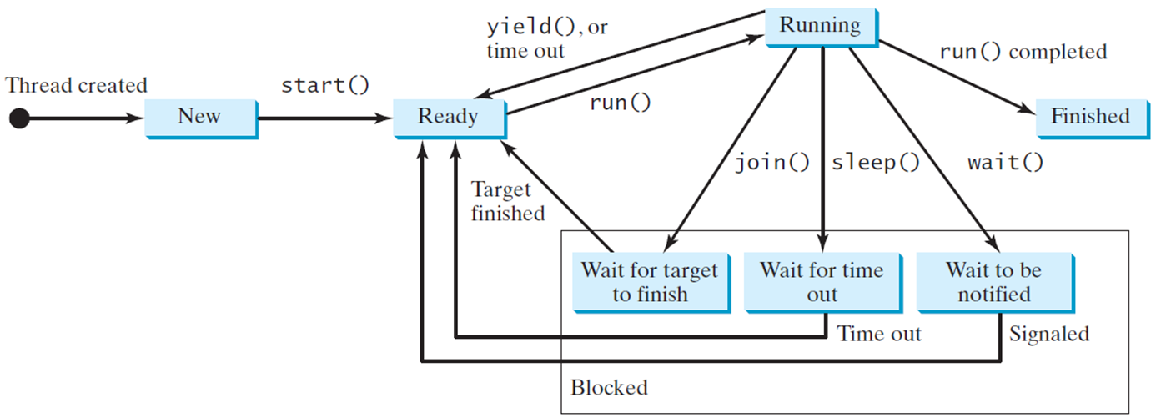
Thread States
A thread can be in one of five states: New, Ready, Running, Blocked, or Finished.
Notes:
An arrow from New to Ready is labeled, Start left parenthesis right parenthesis. An arrow from Ready to Running is labeled, run left parenthesis right parenthesis. An arrow from Running to Ready is labeled, yield left parenthesis right parenthesis or time out. An arrow from Running to wait for target to finish, wait for time out, wait to be notified, and fished is labeled, join left parenthesis right parenthesis, sleep left parenthesis right parenthesis, wait left parenthesis right parenthesis, and run left parenthesis right parenthesis completed respectively. An arrow from wait for target to finish to Ready is labeled, target finished.

Slide 45
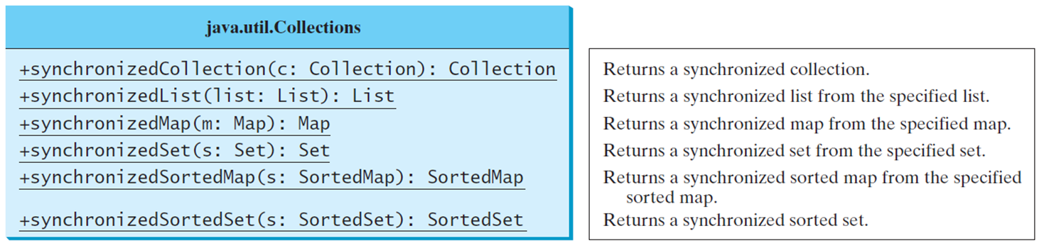
Synchronized Collections
The classes in the Java Collections Framework are not thread-safe, i.e., the contents may be corrupted if they are accessed and updated concurrently by multiple threads. You can protect the data in a collection by locking the collection or using synchronized collections.
The Collections class provides six static methods for wrapping a collection into a synchronized version. The collections created using these methods are called synchronization wrappers.
Notes:
+synchronizedCollection left parenthesis c colon Collection right parenthesis colon Collection. Returns a synchronized collection.
+synchronizedList left parenthesis list colon List right parenthesis colon List. Returns a synchronized list from the specified list.
+synchronizedMap left parenthesis m colon Map right parenthesis colon Map. Returns a synchronized map from the specified map.
+synchronizedSet left parenthesis s colon Set right parenthesis colon Set. Returns a synchronized set from the specified set.
+synchronizedSortedMap left parenthesis s colon SortedMap right parenthesis colon SortedMap. Returns a synchronized sorted map from the specified sorted map.
+synchronizedSortedSet left parenthesis s colon SortedSet right parenthesis colon SortedSet. Returns a synchronized sorted set.

Slide 46
The Fork/Join Framework (1 of 2)
The widespread use of multicore systems has created a revolution in software. In order to benefit from multiple processors, software needs to run in parallel.
J D K 7 introduces the new Fork/Join Framework for parallel programming, which utilizes the multicore processors.

Slide 47
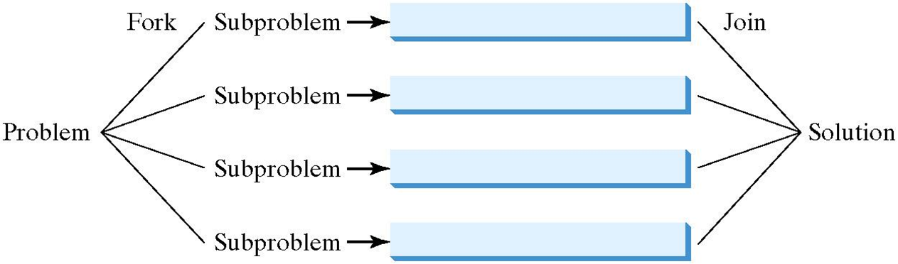
The Fork/Join Framework (2 of 2)
The Fork/Join Framework is used for parallel programming in Java.
In J D K 7’s Fork/Join Framework, a fork can be viewed as an independent task that runs on a thread.

Slide 48
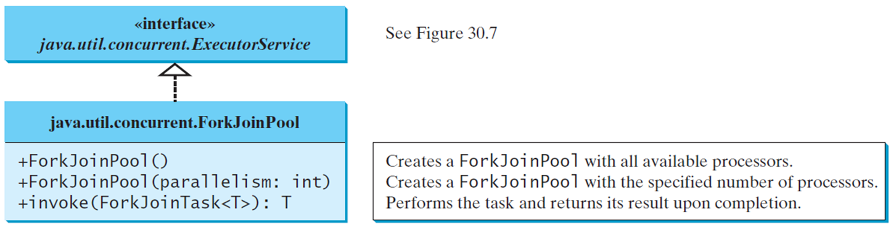
ForkJoinTask and ForkJoinPool
The framework defines a task using the ForkJoinTask class, and executes a task in an instance of ForkJoinPool.
Notes:
java.utiLconcurrent.ExecutorService. (See Figure 30.7). The codes and descriptions for java.util.concurrent.ForkJoinPool are as follows.
+ForkJoinPool left parenthesis right parenthesis. Creates a ForkJoin Pool with all available processors.
+ForkJoinPool left parenthesis parallelism: int right parenthesis. Creates a For Idol n Pool with the specified number of processors.
+invoke left parenthesis ForkJoinTask less than symbol T greater than symbol right parenthesis colon T. Performs the task and returns its result upon completion.

Slide 49
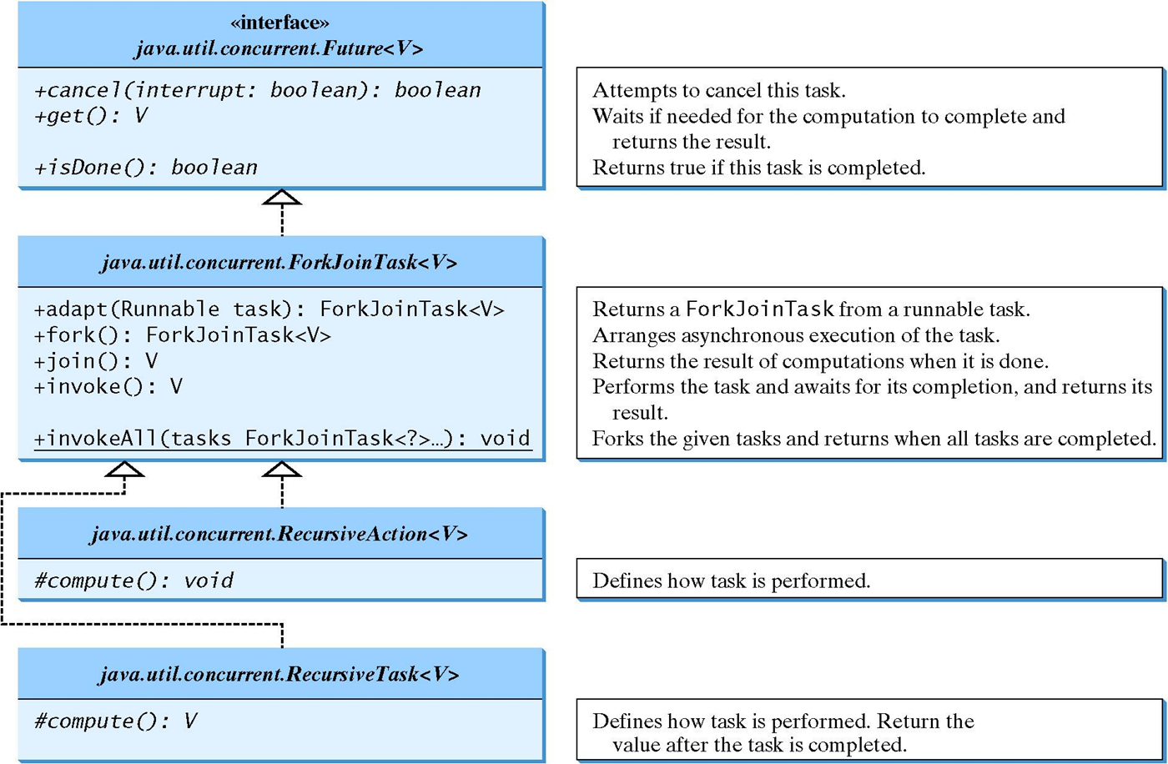
ForkJoinTask
Notes:
RecursiveTask less than symbol V greater than symbol and java.until.concurrent.RecursiveAction less than symbol V greater than symbol leading to java.util.concurrent.ForkJoinTask less than symbol V greater than symbol which further leads to the interface javautiLconcurrent.Future less than symbol V greater than symbol. The codes and description for interface javautiLconcurrent.Future less than symbol V greater than symbol are as follows.
+cancel left parenthesis interrupt colon boolean right parenthesis colon Boolean. Attempts to cancel this task.
+get left parenthesis right parenthesis colon V. Waits if needed for the computation to complete and returns the result.
+isDone left parenthesis right parenthesis colon Boolean. Returns true if this task is completed.
The codes and descriptions for java.util.concurrent.ForkJoinTask less than symbol V greater than symbol are as follows.
+adapt left parenthesis Runnable task right parenthesis colon ForkJoinTask less than symbol V greater than symbol. Returns a ForkJoi nTask from a runnable task.
+fork left parenthesis right parenthesis colon ForkJoinTask less than symbol V greater than symbol. Arranges asynchronous execution of the task.
+join left parenthesis right parenthesis colon V. Returns the result of computations when it is done.
+invoke left parenthesis right parenthesis colon V. Performs the task and awaits for its completion, and returns its result.
+invokeAll left parenthesis tasks. Forks the given tasks and returns when all tasks are completed.
The codes and descriptions for ForkJoinTask less than symbol question mark greater than symbol right parenthesis colon void
Hash compute left parenthesis right parenthesis colon void. Defines how task is performed.
The codes and descriptions for java.util.concurrent.RecursiveTask less than symbol V greater than symbol are as follows.
Hash compute left parenthesis right parenthesis colon V. Defines how task is performed. Return the value after the task is completed.

Slide 50
Examples
ParallelMergeSort
ParallelMax
Notes:
ParallelMergeSort: https://liveexample.pearsoncmg.com/html/ParallelMergeSort.html
ParallelMax: https://liveexample.pearsoncmg.com/html/ParallelMax.html

Slide 51
Vector, Stack, and Hashtable
Invoking synchronizedCollection(Collection c) returns a new Collection object, in which all the methods that access and update the original collection c are synchronized. These methods are implemented using the synchronized keyword. For example, the add method is implemented like this:
public boolean add(E o) {
synchronized (this) { return c.add(o); }
}
The synchronized collections can be safely accessed and modified by multiple threads concurrently.
The methods in java.util.Vector, java.util.Stack, and Hashtable are already synchronized. These are old classes introduced in J D K 1.0. In JDK 1.5, you should use java.util.ArrayList to replace Vector, java.util.LinkedList to replace Stack, and java.util.Map to replace Hashtable. If synchronization is needed, use a synchronization wrapper.

Slide 52
Fail-Fast
The synchronization wrapper classes are thread-safe, but the iterator is fail-fast. This means that if you are using an iterator to traverse a collection while the underlying collection is being modified by another thread, then the iterator will immediately fail by throwing java.util.ConcurrentModificationException, which is a subclass of RuntimeException. To avoid this error, you need to create a synchronized collection object and acquire a lock on the object when traversing it. For example, suppose you want to traverse a set, you have to write the code like this:
Set hashSet = Collections.synchronizedSet(new HashSet());
synchronized (hashSet) { // Must synchronize it
Iterator iterator = hashSet.iterator();
while (iterator.hasNext()) {
System.out.println(iterator.next());
}
}
Failure to do so may result in nondeterministic behavior, such as ConcurrentModificationException.

Slide 53

Copyright
This work is protected by United States copyright laws and is provided solely for the use of instructors in teaching their courses and assessing student learning. Dissemination or sale of any part of this work (including on the World Wide Web) will destroy the integrity of the work and is not permitted. The work and materials from it should never be made available to students except by instructors using the accompanying text in their classes. All recipients of this work are expected to abide by these restrictions and to honor the intended pedagogical purposes and the needs of other instructors who rely on these materials.

